Slide 1
Research Updates:
Objective 3
Survival of Generic Escherichia coli on Plastic Mulch in Open-Field, Greenhouse, and Growth Chamber Environments
Notes:
Introduce the focus of the research: evaluating the survival of generic Escherichia coli on plastic mulch across different environments.
Emphasize the significance of understanding how environmental conditions impact pathogen survival, particularly in agricultural settings.
Briefly mention the environments studied: open-field, greenhouse, and growth chamber.

Slide 2
Research Highlights
E. coli survival was significantly different between environments.
E. coli was detectable for 7 days in the growth chamber and greenhouse.
E. coli was negative post-enrichment by 5 days post-inoculation (dpi) on plastic mulch in the open-field.
A biphasic die-off pattern of E. coli was observed in all tested environments.
The growth chamber overestimated the risk of E. coli persistence on plastic mulch.
Notes:
Highlight the key findings:
E. coli survival varied significantly between environments.
Detectable for 7 days in growth chamber and greenhouse, but only until 5 days post-inoculation (dpi) in the open-field.
Point out the biphasic die-off pattern observed in all environments.
Discuss the rapid initial die-off in the open-field compared to the slower decline in the greenhouse.
Conclude by noting that growth chamber results may overestimate the real-world persistence of E. coli on plastic mulch.

Slide 3
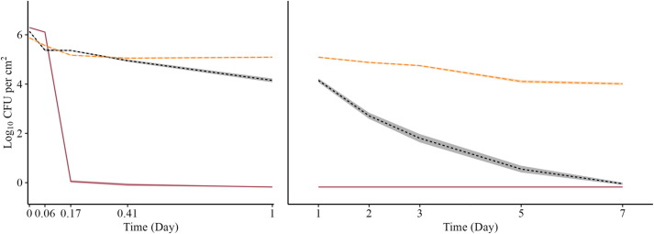
Generic Escherichia coli log CFU/cm² Across 0 to 7 Days on Plastic Mulch
A drastic initial E. coli reduction of -1.65 log CFU/cm²/hour was observed in the open-field from 0 to 4 h, while the greenhouse environment exhibited a slower and longer period of initial
E. coli decline at -0.06 log CFU/cm²/hour from 0 to 59 h.
Open-field - solid, red
Greenhouse - dashed, black
Growth Chamber - long dashed, yellow
Notes:
Introduce the survival curves graph comparing E. coli levels across time in different environments.
Highlight the distinct die-off patterns for open-field, greenhouse, and growth chamber.
Reinforce that E. coli was undetectable by 5 dpi in the open-field, while still detectable at 7 dpi in the other environments.
Explain the potential reasons for these differences: exposure to sunlight, temperature fluctuations, and environmental stressors in the open-field versus more controlled conditions in the greenhouse.

Slide 4
Generic Escherichia coli log CFU/cm² Across 0 to 7 Days on Plastic Mulch
In the open-field, E coli was undetectable by 5 dpi, while E. coli in the greenhouse and growth chamber remained detectable up to 7 dpi.
The >6 log E. coli reduction on plastic mulch held in the field and greenhouse environments suggests the food safety risk of plastic mulch alone is minimal.
Open-field - solid, red
Greenhouse - dashed, black
Growth Chamber - long dashed, yellow
Notes:
Continue discussing the data showing log reductions over time.
Emphasize the significant log reductions (>6 log) observed in both the field and greenhouse, indicating limited long-term survival.
Explain that the minimal risk suggested by these findings reduces concerns regarding plastic mulch as a persistent contamination source.

Slide 5
Generic Escherichia coli log CFU/cm² Across 0 to 7 Days on Plastic Mulch
These results demonstrate that the survival of E. coli on plastic mulch is environment-dependent, indicating not all production environments have the same risk.
Open-field - solid, red
Greenhouse - dashed, black
Growth Chamber - long dashed, yellow
Notes:
Further interpret survival curves to demonstrate how environment influences microbial persistence.
Reiterate that E. coli survival on plastic mulch is not uniform across environments.
Note the importance of considering environmental conditions in food safety risk assessments.

Slide 6
Generic Escherichia coli log CFU/cm² Across 0 to 7 Days on Plastic Mulch
Field and greenhouse environments should also be included and prioritized in produce safety research as the laboratory-based experiment overestimated risk in the present study.
Open-field - solid, red
Greenhouse - dashed, black
Growth Chamber - long dashed, yellow
Notes:
Summarize the practical implications:
Laboratory (growth chamber) studies may overestimate pathogen risks.
Field and greenhouse studies provide a more accurate reflection of actual risk.
Suggest that produce safety research should prioritize including diverse environmental conditions.

Slide 7




More Information
Check out our paper!
Alyssa A. Rosenbaum
Graduate Research Associate
University of Arizona
alyssaar@arizona.edu
Laura K. Strawn, Ph.D.
Associate Professor
Virginia Tech
laurakstrawn@vt.edu
This work is supported by the Specialty Crops Research Initiative [grant no. 2020-51181-32157] from the USDA National Institute of Food and Agriculture. Any opinions, findings, conclusions, or recommendations expressed in this presentation are those of the speakers and do not necessarily reflect the view of the U.S. Department of Agriculture.
Notes:
Acknowledge funding from USDA’s Specialty Crops Research Initiative.
Provide contact information for the researchers: Alyssa Rosenbaum and Dr. Laura Strawn.
Encourage the audience to check out the related published paper for more detailed information.

